Slide 1
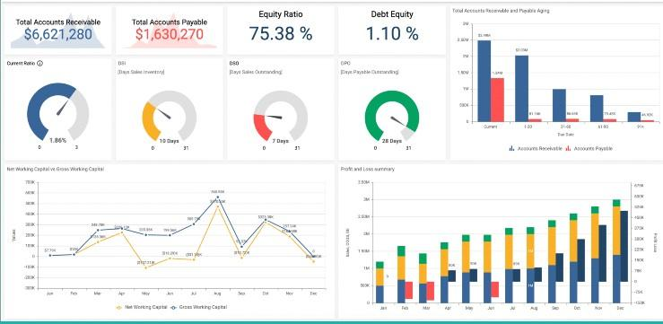

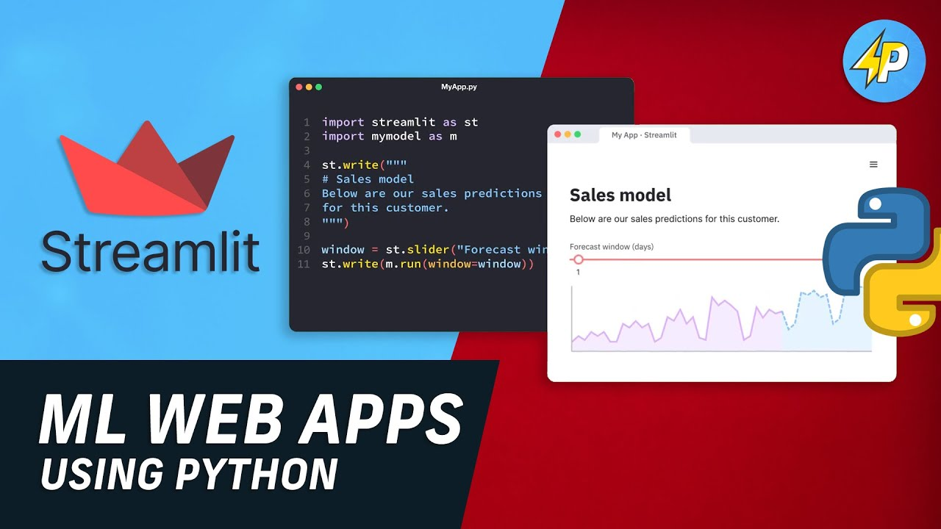
Introduction to Streamlit
ADS

Slide 2
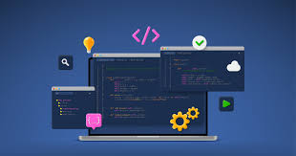
What is Streamlit?
Streamlit is an open-source Python library that makes it easy to create web applications for machine learning and data science projects. It allows you to create interactive web apps using simple Python scripts.
Streamlit Scripts:
A Streamlit script is a Python script that uses Streamlit's API to define the layout and behavior of a web application. It typically contains a series of Streamlit commands that create and configure interactive elements such as sliders, buttons, and plots.

Slide 3
Elements of Streamlit
Widgets:
Interactive elements that allow users to interact with a Streamlit app. Examples of widgets include sliders, buttons, checkboxes, and text inputs. Widgets can be used to input data, control the behavior of the app, and display output.
DataFrame:
A tabular data structure used in Streamlit to represent data. It is similar to a spreadsheet or a database table, with rows and columns. DataFrames can be created from various sources such as CSV files, Excel files, or Python data structures.
St.cache:
A decorator provided by Streamlit that allows you to cache the results of a function. This can be useful for expensive computations or data loading operations, as it allows the app to reuse the cached results instead of recalculating them every time the app is rerun.

Slide 4
Elements of Streamlit (Continued)
Markdown:
A lightweight markup language that allows you to format text in Streamlit apps. You can use Markdown to create headings, lists, links, and other text formatting in your app's interface.
Callbacks:
Functions that are called in response to user interactions with a Streamlit app. For example, you can define a callback function that is called when a button is clicked, allowing you to update the app's state or perform other actions based on the user's input.
Session State:
Allows you to store and access information across different sessions of a Streamlit app. This can be useful for storing user preferences or maintaining the state of the app between different interactions. Think of Session State as a memory bank that seamlessly shares variables between reruns for each user session, ensuring a smooth, interference-free user experience.

Slide 5
Essential Syntax
Importing Streamlit: To use Streamlit, you need to import it at the beginning of your Python script: import streamlit as st
Displaying Text or DataFrame: You can display text or data frame in your Streamlit app using st.write(“String”): or st.write(df):
Displaying Headers: Headers can be displayed using st.header(“String”) and st.subheader(“String”):
Displaying Widgets: Streamlit provides various widgets for user interaction, such as sliders, buttons, and text inputs. Here's an example of displaying a slider: number = st.slider("Select a number", 0, 100, 50)
Displaying Plots: You can display plots using libraries like Matplotlib:
import matplotlib.pyplot as plt
plt.plot([1, 2, 3, 4])
st.pyplot(plt)

Slide 6
Essential Syntax (Continued)
Running the App: To run your Streamlit app, use the streamlit run command followed by the name of your Python script in the terminal or command prompt:
streamlit run app.py
Viewing the App: Streamlit will start a local development server and provide a URL where you can view your app in a web browser.
These basic syntax concepts can help you get started with Streamlit and allow you to create simple yet interactive web applications!
**To install streamlit, run the following in your terminal: pip install streamlit

